Slide 1
Sex, Gender, and Sexuality
Chapter 11

Slide 2
Sex, Gender, and Sexuality
Sex
  Genetic
  Hormonal
  Gonadal
  Genital
  Inter
Gender
  Socialization
  Stereotypes
  Culture
  Behaviors
  Instrumental
  Expressive
  Variant
  Androgyny
Self-Reflect questions (page 380)

Slide 3
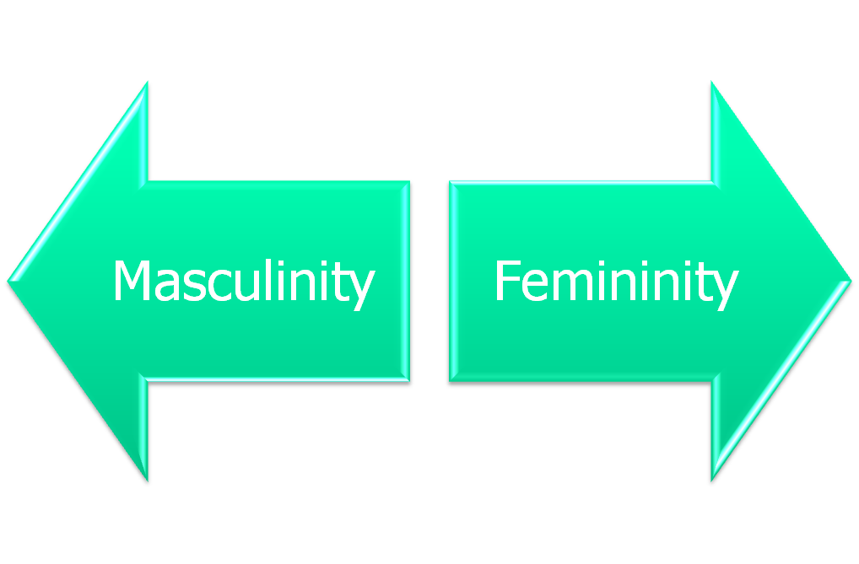
Gender
Gender orientation

Slide 4
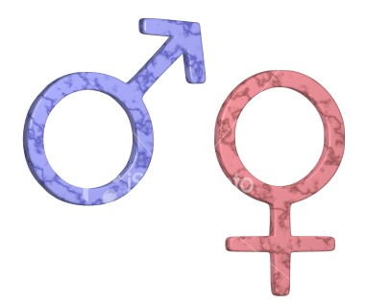
Sexuality
Rating | Description
0 | Exclusively heterosexual
1 | Predominantly heterosexual, only incidentally homosexual
2 | Predominantly heterosexual, but more than incidentally homosexual
3 | Equally heterosexual and homosexual.
4 | Predominantly homosexual, but more than incidentally heterosexual
5 | Predominantly homosexual, only incidentally heterosexual
6 | Exclusively homosexual
X | Asexual, Non-Sexual
Sexual orientation
  Heterosexual
  Homosexual
  Bisexual
  Kinsey scale

Slide 5
Sexuality
Men
  11.6% of white males aged 20–35 were given a rating of 3 for this period of their lives.
  The study also reported that 10% of American males surveyed were "more or less exclusively homosexual for at least three years between the ages of 16 and 55" (in the 5 to 6 range).
Women
  7% of single females aged 20–35 and 4% of previously married females aged 20–35 were given a rating of 3 for this period of their lives.
  2 to 6% of females, aged 20–35, were given a rating of 5 and 1 to 3% of unmarried females aged 20–35 were rated as 6.

Slide 6
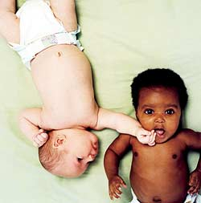
Sexuality
Sexual prejudice
  Hostility
  Myths

Slide 7
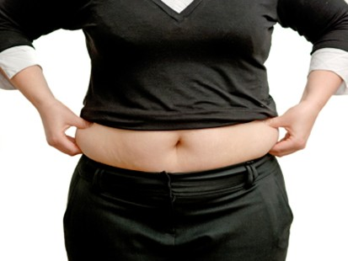
Sexuality
Appearance schemas
  Beliefs about self or parts of self that develop from interaction with others
  Reinforced over time and though multiple experiences
  Become automatic
    Face
    Legs
    Hips
    Arms
    Feet
    Neck
    Stomach
    Breasts
    Buttocks
    Thighs
    Hands

Slide 8

Sexuality
Sociocultural norm for ideal appearance
  Cosmopolitan (sex and body linked)
  Music videos (skimpy and provocative)
  Fashion shows (skinny and trendy)

Slide 9

Sexuality
Critical thinking
  Are we over-sexualizing young girls? (page 388)
  Pornography and sexual scripts
    Mirror neurons
  Gender role stereotyping and rape? (page 389)
    Develop a UVU rape prevention plan

